Slide 1
Braden’s Intro Slide(s)

Slide 2

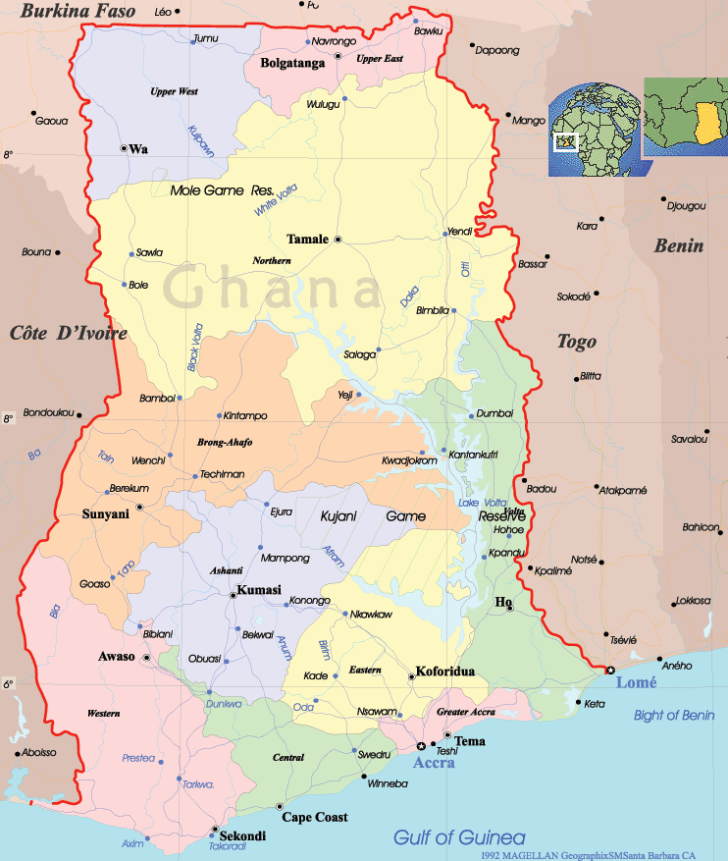
Ghana
The Challenge: Use CRS’s core capabilities to address areas of mutual need for their beneficiaries and large companies, creating shared value for both groups and diversifying CRS’s funding sources.

Slide 3





Corporate Sector Engagement: The Race is On
Companies are already aware of the opportunity and value to NGO relationships, and are actively seeking partners.
Partnership established in 2011
Addressed community development issues in regions impacted by Coca-Cola’s supply chain in El Salvador and Namibia
CRS received $5.5M in grants to diversify coffee farmer livelihoods in Central America
Led to strategic engagement to improve farmers’ carbon footprint
Established foundation to support and develop communities impacted by mining
Funded by 1% of Ghana mining profits, a total of $17M to date

Slide 4
CRS’s Unique Advantages
Microfinance: Beneficiaries Impacted Per $1000
Company Needs
CRS Core Strengths
Behavior change communication expertise
Monitoring & evaluation techniques
Proven sustainability of results
CRS executes programming more efficiently that corporate foundations.

Slide 5

Corporate Sector Engagement Possibilities
Execute programming using company’s corporate social responsibility budget
Companies will maximize impact from same CSR investment
1. Corporate Social Responsibility
Use CRS expertise to strategically improve company operations
Livelihoods Education Health & Sanitation
2. Complement Core Operations
Sustained Community Development
Commercial Irrigation Project
WASH Programming

Slide 6
Aligning CRS with Business
Business negotiations differ greatly from the grant-writing process and require new capabilities.
Partners
Staff
Execution
Alignment Needs
Timing of negotiations
Decision making authority
Corporate vetting process
Sufficient staff bandwidth
Elements of CSE
Notes:
Who does it?
How does it get done?? (Timing, pace, structure)
Who can we partner with
Decision making authority
All NGOs vs values-based NGOs
Happens at table – no skills or timing
Values-based org – even more complicated
Who can do this and do they have the skills?

Slide 7
CRS Ghana: Agreed Upon Next Steps
1
Country Representative in the process of arranging meetings with Newmont, Nestle, Wienco, and Exxon Mobil
2
Business Development Specialist and Fellow developing value proposition presentation for company meetings
3
Country Representative adding CSE to the agenda for Ghanaian conference of bishops meeting in early May
Prepare
Negotiate
Engage
Notes:
CRS Ghana is poised to serve more beneficiaries and actually gain financial independence by innovating in CSE space.
Skepticism => seeing it – converted over 2 weeks
Ghana realized that they walked away from money and how much good it could do

Slide 8
Health System Strengthening
Cambodia
Notes:
1. A second set of field insights focused on HSS initiatives in Cambodia. We are going to address the question of nutrition in Cambodia next, but during our in country emersion we were also able to gather some insights that might apply beyond nutrition programming and contribute specifically to the HSS work in Cambodia.

Slide 9
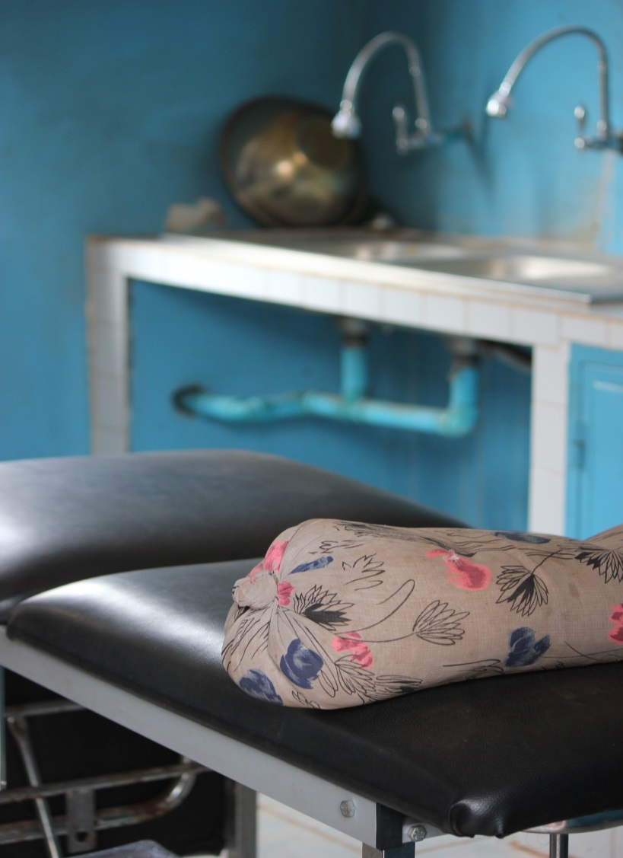
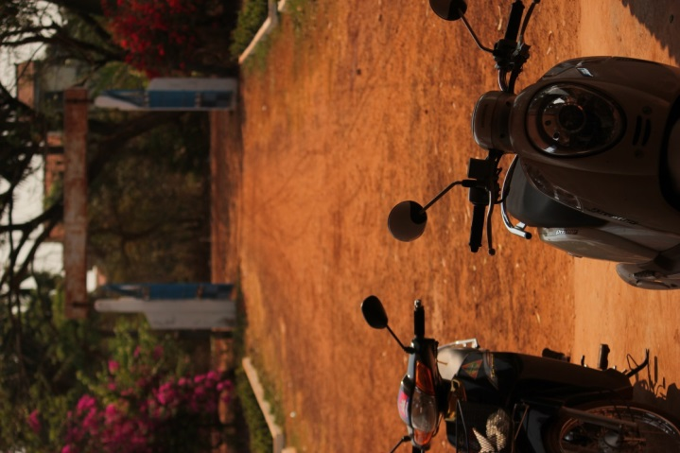
Health Center Underutilization
Notes:
Coming from Kenya, where I was born, and South Africa, where I was raised, I had an image in my head about what a village health clinic looked like. Loud. Dirty, Crowded, Two to three people in a bed. Nurses running around. Mothers and children playing and feeding and waiting…and waiting….and waiting….Lines every day, all day, people even spending the night waiting.
You can imagine my surprise when we walked into our first village health center that Tuesday morning. Perfectly manicured lawns, empty chairs, calm chatty nurses and midwives….and almost no patients. Empty Beds. 14 empty rooms. 4 patients (including caregivers). 14 staff. Now I assume that, alerted to our visit, the staff showed up en masse. But the patients…where were the patients?
This was particularly surprising given all I had read about Cambodia's initiatives around free healthcare for the poorest of the poor. And we were in one of the poorest districts. I thought to myself, no wonder nutrition programming isn’t having an impact – there is nobody hear to treat? But why?

Slide 10
Attitudes of Discrimination
“(even though I have ID Poor Card) I borrow from my aunt to go to private clinic” – PN
“Poor spend their money on the wrong things (alcohol), they are lazy, they do not work hard”
– Commune Chief in KC
“of course it hurts. Stop complaining.”
You can bring it to Kampang Puy, but don’t even bother to bring it to (much poorer) Bannan. They would rather drink bull piss than purify their water”
Notes:
My team also couldn’t shake this question, although other health centers were not quite as sparsely populated, it seemed to us that as compared with both our experiences and our expectations, Cambodia’s Free Public Health Centers were largely underutilized. This observation was confirmed both in the data collected by CRS Cambodia’s photon narrative project (where poor families were identified through the HC, and given digital cameras to record their food related activities and then interviewed to narrate the pictures), where those who had access to the free health care would save or borrow money to access private clinics that were staffed by the same workers as they could have access to in the free HC.
We decided to dig further. We amended our questions to figure out the general place of the free HC for Cambodian beneficiaries, not simply the role of the HC in nutrition services.
We found that Cambodian villagers give 2 main reasons for choosing to pay for services that they could otherwise receive free.
Free clinics take a long time. They have limited hours. And unlike the loose conceptualization of “Kenyan time”, Cambodians are very much in tune to the time value of money.
But most surprisingly, we heard a number of stories that indicated that it wasn’t the hours waiting that was dissuading some villagers, it was the way that they were treated. Let me provide a few examples.
The young woman giving birth to her first child, screaming in pain, was met with the response from her midwife “of course it hurts. Stop complaining.”
The peace corps worker who was asking the nurses in the clinic to donate some water purification pills after a flood who said, “You can bring it to Kampang Puy, but don’t even bother to bring it to (much poorer) Bannan. They would rather drink bull piss than purify their water”
Even the commune chief talked about the poor as “lazy and spending their money on drinking”

Slide 11
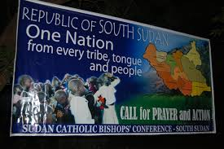
Strategic peacebuilding
Average income cambodia 1980- build two bar charts (one of avg income, other of disparity)
Average income cambodia 2014
Disparity in cambodia (gini) 1980
Disparity in cambodia (gini) 2014
Picture of PP
Picture of village
CRS does this in other places to great success (Ghana HIV example- ask Katie)
Notes:
Now, this is not to say that negative attitudes to the poor is anything new – even here in the United states. But the unique history of Cambodia may have created conditions where these attitudes are more deeply held than in other places. 30 years ago, after the Khmer rouge and the Vietnamese occupation, every Cambodian started off in the same place. With nothing. Those who have been able to transform themselves are likely to see this as due to their own hard work and skill. Consequently, it appears as if they see that those who have not been able to do so, are poor because of their own choosing. Even among those who care fore the sick, and govern the poor, these attitudes prevail.
We see this as a unique opportunity for CRS to use one of its core capabilities – Strategic Peacebuilding- in a new and innovative way to strengthen Health systems in Cambodia. Like you have used to combat the stigma of HIV, you can similarly use your capacity here. If nurses and midwives, instead of being taught only technical skills, could also be taught in the provision of empathy, they might treat their patients with greater care. If that could occur, then proud status conscious poor Cambodians might feel that taking advantage of their free health care could be a blessing rather than something that brings them shame.

Slide 12
Nutrition Programming (add big background pic of food) Rwanda, Cambodia, Guatemala

Slide 13
Rate of Malnutrition in Rwanda, Cambodia and Guatemala
Percentage of stunted children >5 by Country
Percentage of stunted children >5 by Region
Notes:
These are 3 countries that suffer malnutrition problems,

Slide 14
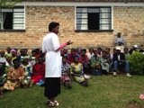
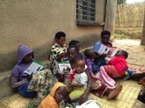
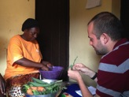
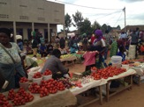
Building Blocks to Improve Nutrition
CRS Nutrition Programming
Information
Knowledge
Action
Availability
CRS Health Strategy Outcomes
Individuals demonstrate improved nutrition practices
Communities address nutrition needs
Improved quality of nutrition health care services

Slide 15
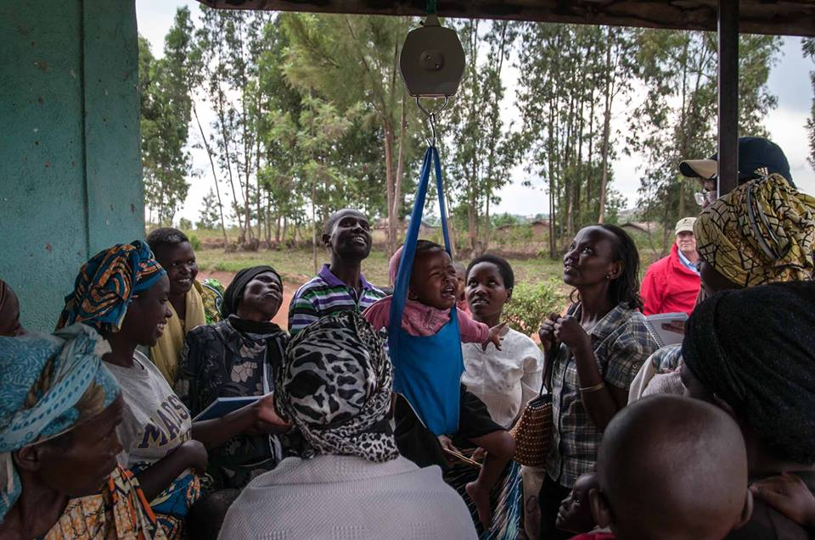
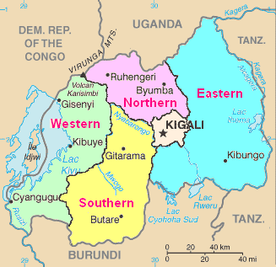
Rwanda
In 2005, more than half of Rwanda’s children under 5 were stunted. Just five years later, stunting prevalence had decreased from an estimated 52 percent to 44 percent. [look for better quote from Kagame]
“the success story”
The Challenge: Build a more efficient and effective model to rapidly decrease rates of malnutrition and stunting

Slide 16
Information
Knowledge
Action
Availability
CRS Rwanda has some of the best nutritionists in all of CRS
Poor rate of knowledge transfer
Training often does not reflect needs of beneficiaries
People have adopted kitchen gardens and are trying to act on the knowledge they receive
There is an abundance of food available on market day
Some families sell excess crops from their kitchen gardens
Notes:
Show w/ quick dataor quick stories that it’s not the other three but it’s knowledge
-check whether Rwanda is net importer or net exporter to support 4th point
not so black and white- we saw more of a gap where CRS can invest in these areas

Slide 17
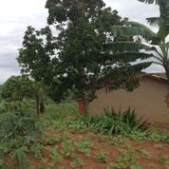
Training: A game of Broken Telephone
Existing training strategy is not effectively transferring information into knowledge
CHWs provide information verbally, so basics are covered repetitively (sanitation, hand washing)
Training is given in large groups, participants are often distracted by their kids and each other
“People share seeds to diversify their diet, but seed sharing results in poor crop output”
85% of mothers exclusively breastfeed, but many do so incorrectly
Young teenage caregivers attended breastfeeding training instead of the mothers
Notes:
More solution based than problem based- frame stories to show that there is a problem, don’t identify the solution yet
-More data to illustrate this point
-observations around the game of broken telephone

Slide 18
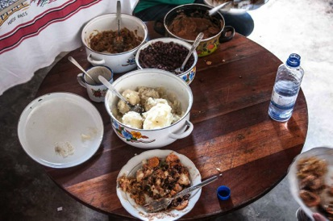
Curriculum Gaps
Beneficiaries desire further material to support and enhance their knowledge development
“I want to learn more planting techniques”
“I forget what ingredients go into the food we prepared”
“I’m buying vegetables because my kitchen garden doesn’t work in the dry season”
It is taken for granted what beneficiaries already know- cassava leaf example
Notes:
Is it that they ask for some things but get others……..and bc crs is train the train the train…..they aren’t responsive
At this point you don’t need conclusions…only data………..materials is an answer not an observation.
I want more planting but they’re teaching BF
Want more or different things

Slide 19
CRS Opportunity #1
Optimize Current Programming
CRS nutrition program reaches critical mass faster & more efficiently with enhanced training and materials
Pamphlets for beneficiaries with pictures
Consistent messaging of best practices
Decrease teacher-student ratio for training sessions
Rate of Malnutrition (<5)
[Extrapolated rate of malnutrition from CRS monitoring activities]
Year
Notes:
Attacking the Knowledge Problem!

Slide 20
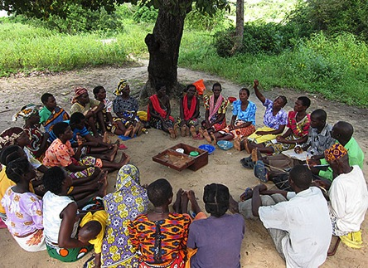
CRS Opportunity #2
PSP + Nutrition Model
Overlay nutrition training sessions onto a sustainable practice, PSP + SILC groups
Provides consistent support for nutrition questions & techniques
Disseminates information in a sustainable forum
Provides opportunity to identify members in need of additional nutrition support
Notes:
“Attacking the Knowledge problem (action, availability)”

Slide 21
Cambodia
“the stalled truck”

Slide 22
Information
Knowledge
Action
Availability
Insert Data
Insert Data
Insert Data
Training
Materials
Critical mass of people know what is healthy
Cooking with the right foods
Growing the right foods
Barriers to action e.g. “eat rice” Khmer: overreliance on rice
Cultural beliefs detrimental to nutrition ” PLM drink rice wine to stimulate breast milk production

Slide 23
Insights that show that Action lacks
Barriers to action are behavioral- people cook veggies but only eat the rice
High value placed on being thin

Slide 24
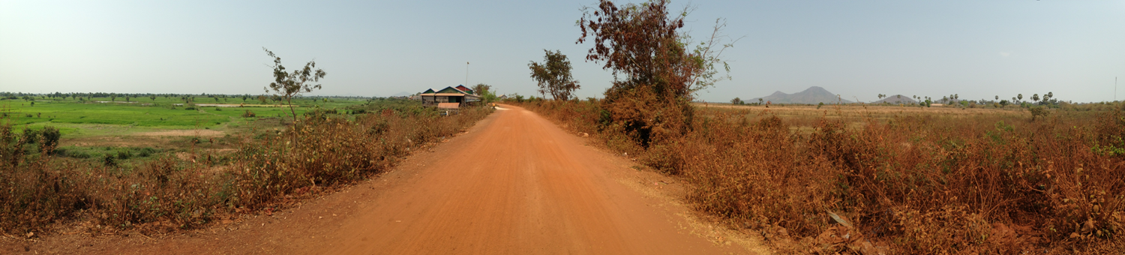
Segmentation can increase the success and efficiency of programs
Programming
Targets
What: Break down wide market into homogeneous groups of individuals with similar characteristics, wants or needs
How: Use psychographic and behavioral observations to identify first adopters
Why:
Segmentation helps identify and address the different needs of each segment
Reach more people by targeting less → increase efficiency and effectiveness of resources
Cooking
Instruction
Education
Notes:
If you are thinking of the best way to connect and engage with people, you break them down into segments or groups that have commonalities that allows you to reach them easier. Once you have these groups, how do you relate to them so they put their nutrition knowledge into action? To be most successful, we tie them into core values.

Slide 25
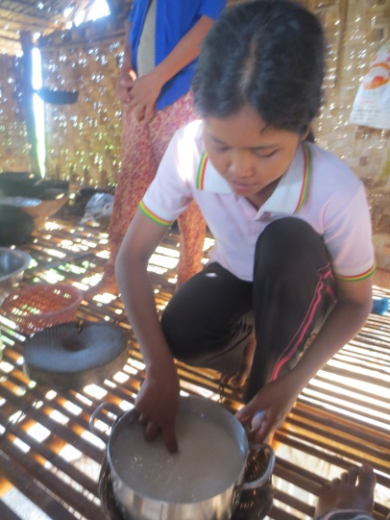
Aligning Programming by Core Values
“Quote” – San Thrun
Cambodia Core Values
Reputation & Social Status
Hard Work
Family
Independence & Dignity
Karma
Notes:
Story about San Thrun

Slide 26
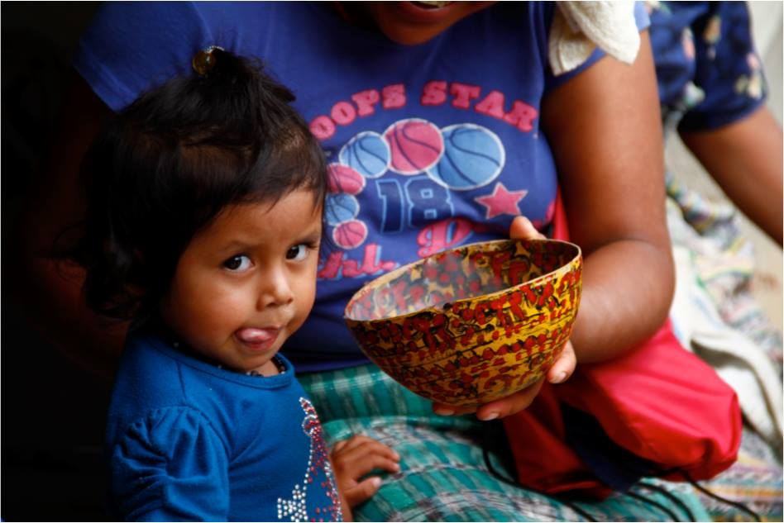
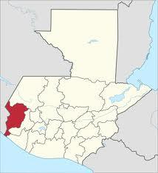
Guatemala
“Even if they had enough money to spend on food and they chose all the “right” food, there would still be deficiencies in the diet. Good food is just not accessible.”
Eric Janowsky, USAID/Guatemala
Director, Health and Education Office
“The Food Desert”
The Challenge: Reduce chronic childhood malnutrition in an areas with limited food availability.
Notes:
San Marcos Region
85% of population lives in poverty or extreme poverty
Highest rate of malnutrition among children under five in Latin America (Oxfam)
Malnutrition rate is close to 70% for indigenous children (World Food Program)
Dietary staple is corn
USAID OptiFood evaluates the nutrition density of foods available

Slide 27
Information
Knowledge
Action
Availability
Adequate nutrition is unavailable in Guatemala as shown by the Optifood tool, which assesses the nutrition content of local food baskets.
NGOs and farmers are aware of the need to improve their nutrition.
CRS is successfully implementing community development programs, supporting “promoters” to train other families in health/nutrition.
Access to nutrient-dense food is a number one priority.
Chronic malnutrition rates cannot be reduced without nutrition-rich food availability.

Slide 28
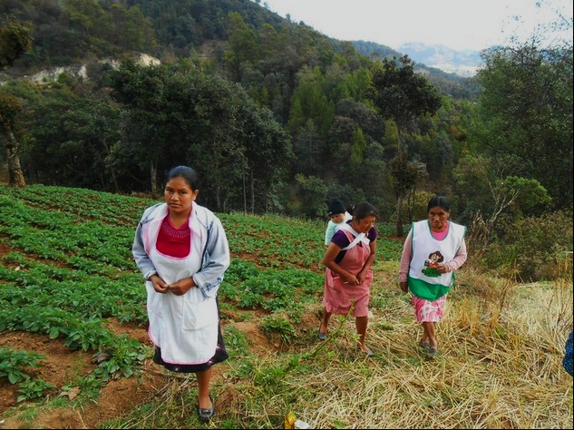
Atol, Tortillas, and Beans
The Food Desert
Diet: corn and beans
Animal protein: limited, at most once per week
Spending money: soap, sugar, oil
Diversity: Lacks crop diversity
Junk food: easily accessible and cheap in local shops
Higher income and more health & agricultural programming does not necessarily equal higher levels of nutrition. Often, there is no access to products of nutritious value.

Slide 29
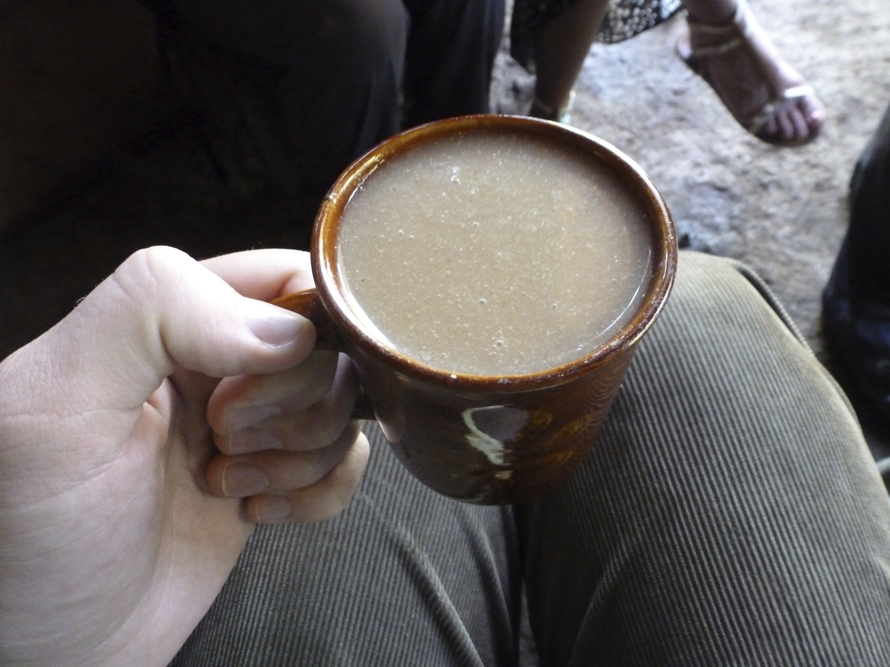
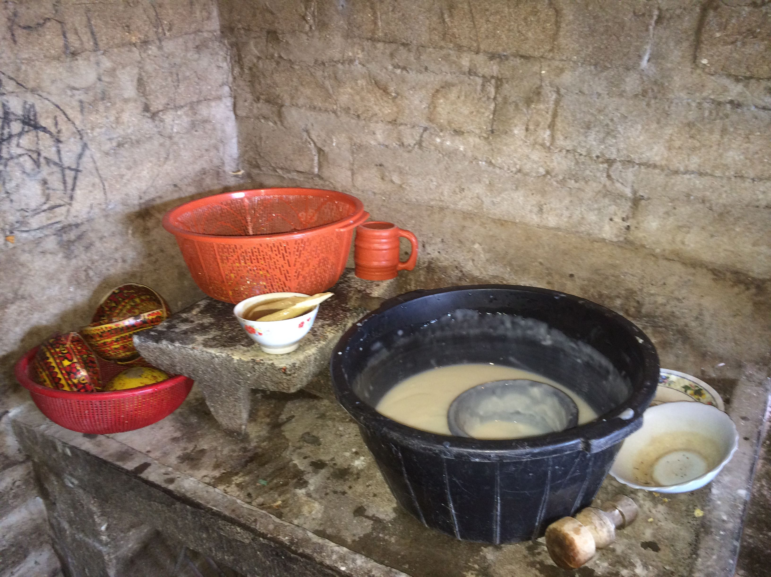
Amaranth: A Strategic Solution
A study in Mexico demonstrated:
13g of amaranth concentrate per day reduced 75% of mild-moderate child malnutrition
Amaranth can round out the food basket and improve childhood nutrition.
Amaranth

Slide 30
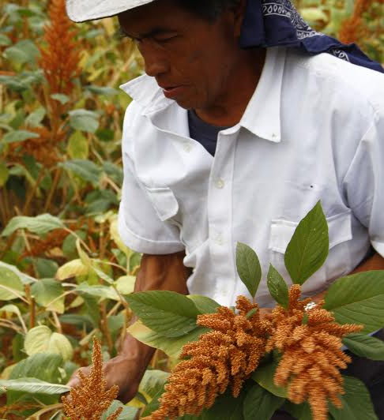
Amaranth: A Win-Win Solution
Supporting amaranth cultivation is a viable strategy to address malnutrition & improve standards of living, by forming a nutrient-rich and economically attractive value chain.
Recommendation
Nutrition Benefits:
Improves nutrition density
Counters food desert, healthier food available
Improves Livelihoods:
Economically attractive
Long-term and sustainable solution
Notes:
How might we use Amaranth to improve nutrition among poor farming families in rural San Marcos, Guatemala?
This is a hypothetical figure assuming average sale prices and crop yields for amaranth and corn for a small farmer
Unmet demand in Guatemala city, importing from Mexico

Slide 31
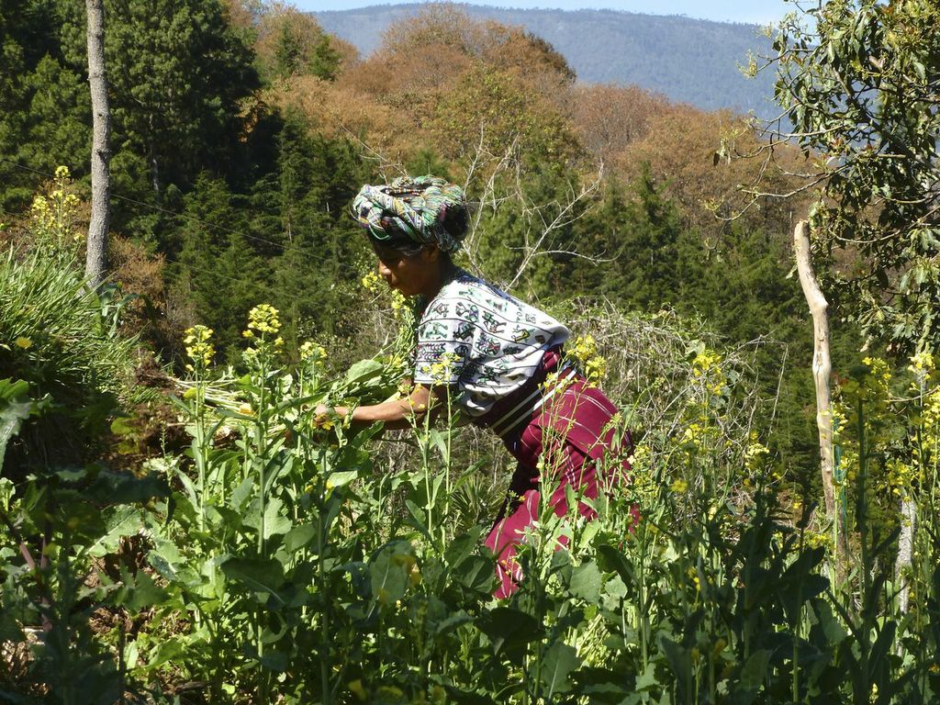
Strategic Programming for the Food Basket
Design programs strategically around gaps in the existing food basket creating a nutrient dense food supply.
Grains can be easily incorporated into the diets of infants.
Seek out regionally appropriate crops that provide both nutritional and economic benefits to encourage adoption.

Slide 32
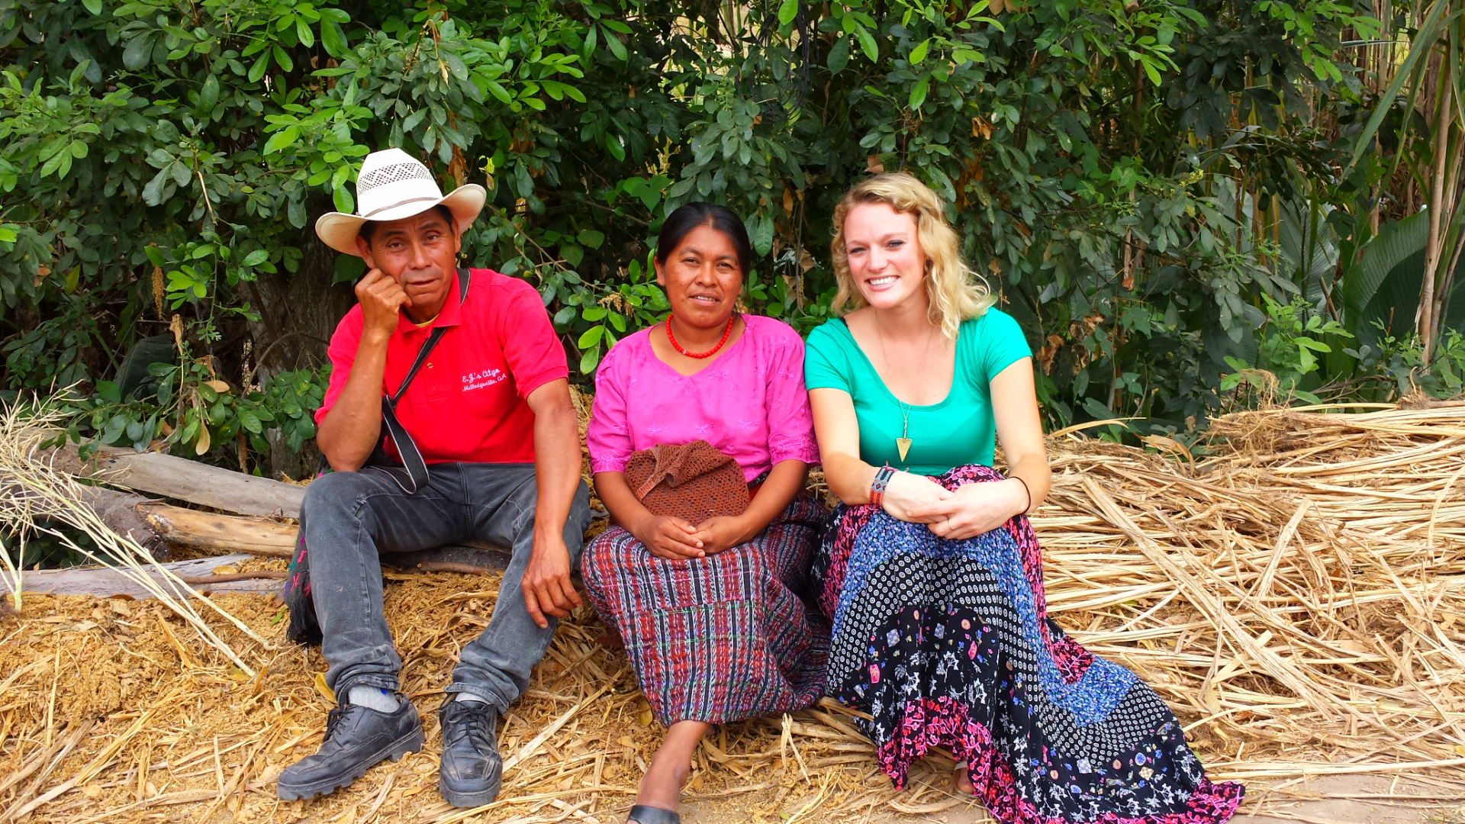
Key Learnings
A pic of each of us in country

Slide 33
Conclusion
Here is what BOTFL 2014 has identified:
You can’t wait for next year
As w/ any innovation, efficiency’s will run you down to nothing. The Programs that create real value at CRS have flexibility. Exemplified by Amaranth in Guat, the ‘better designed behavior change program’ in Cambodia to really address the underlying issue behind stunting. What BOTFL Ghana found was that you can get the funds for flexible programs, programs that let you pivot like the most efficient entrepreneurial firms. CRS is ‘picky’ on where the dollars come from, so You MUST move first to take advantage of that shorter list of available flexible funding partners.
Need to incorporate this also: “What the Nutrition programs in Cambodia shows is that Millions can be spent, and the needle won’t move. The programs are trying to fix the wrong part of the problem, and implementors can’t pivot to fix the underlying issue. CRS can be that agent that moves first, and actually moves the needle. This can be applied to the global organization, and be a leader in the innovation of NGO programming”
Notes:
What does the future of development look like?
The NGO space is becoming more competitive and crowded. There are fewer opportunities for funding, funding comes with more and more strings. Meanwhile, NGO as an industry has a larger and larger mouth that it has to feed. MGDs are not being met, millennial villages did not work and people are starting to debate the NGO field as a solution. CRS will not be affected first or the most bc of its size and reputation, but that doesn’t mean it changes in the longrun. How do you continue to operate in ghana or rwanda and care for the poorest of the poor as society as a whole becomes elevated out of poverty. How do you continue to operate in places like Liberia where post=war reconstruction money runs out but people are still in need. How do you continue to operate ni a place like Cambodia where you are just starting nutrition programmin (which is at 44%) but you have extensive HIV programming, but the rate is at 3%. Gates is driving programming in Cambodia- Gates has been around for 10 years and CRS has been around for 70. The way CRS today trys to influence their funding is before the RFP to lobby in advance to shape what kind of propsals go out but they’re still stuck with the constraints of programming. That’s how you end up with a third of your helath programming in Cambodia going to HIV/AIDS. CRS is the big fish. Yo are the 2nd largest international aid organization in the world behind red cross. You should be setting the agenda, not running after funds. Word of the day is proactivity. We have some really good examples of proactive programs that are going orbeing attempted in contry programming. In ghana, on the backs of a couple of people they are tyring … In Cambodia they competitively bid for funding from Baltimore. IN Guatemala, amaranth is being pursued bc they have extra funding. In rwanda, they are looking to improve current programs so the EKN program can be infinetly more effective. These programs are not the bread and butter, but they SHOULD BE. The majority of what CRS is doing should be this high-impact, high-innovation bc if they can’t do it, then who??? This is why CSE is so important. Going back to Ghana, that’s how you can afford to be innovative. As long as you are hampered by 10yo USAID progjects that specify every minute detail across a 10 year period, you’ll never have room for that innovative spirit. Businesses can be efficient or they can be innovative. Right now the aid industry is efficiensy-ing itself to death.

